Slide 1
CHAPTER 11: EXCEL Add-In
Day 12

Slide 2
CHAPTER 11: EXCEL Add-In
You can use SAS Data Steps, Proc SQL, and Macros! Can life get ANY Better?
YES! We can take our data and stick it in Excel for easy Reporting!
We now Optimize on both programs strengths, SAS’s data manipulation and Excel’s easy visuals!

Slide 3
CHAPTER 11: EXCEL Add-In
Step one!
  Get your data into a suitable form i.e. with the variables you want in your report and summed or averaged the way you want
Step two!
  Decide if you want to put the data in an Excel Pivot Table for further manipulations or, if it is ready to look at and make graphs out of, put the data directly into Excel EXACTLY as it looks in your SAS dataset

Slide 4
CHAPTER 11: EXCEL Add-In
Why go through this?
By putting the information into Excel we can update our Excel tables and pivots (rerun our code month to month if need be) just by running your SAS code with the new months data that is now linked to the excel tables and pivots.

Slide 5
CHAPTER 11: EXCEL Add-In
So lets take our macro we created last time but:
  Remove the macro variable that is in the name of our final output table.
  Add the customer libname to the table you create so it stores in that folder on your computer.
Remove
proc sql;
create table customer.als_all_dq_change_&past_due. as
select distinct me_dt,
sum(me_balance) as me_balance format dollar20.0,
sum(DQ_Balance) as dq_balance format dollar20.0,
sum(DQ_Balance)/sum(me_balance) as pct_DQ format percent8.2
from als_all_dq
group by me_dt;
quit;

Slide 6
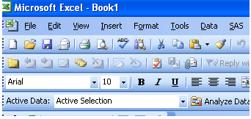
CHAPTER 11: EXCEL Add-In
Now we are going to take this dataset and put the whole thing into an Excel sheet.
Hopefully you successfully added the SAS Add-In and you should see this:

Slide 7
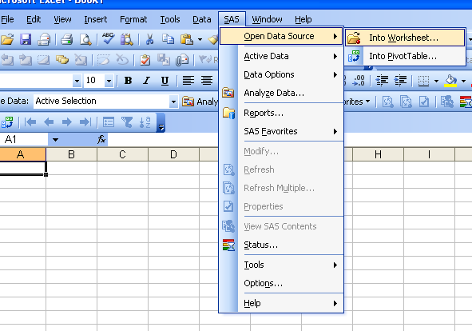
CHAPTER 11: EXCEL Add-In
Select SAS ➔ Open Data Source ➔ Into Worksheet

Slide 8
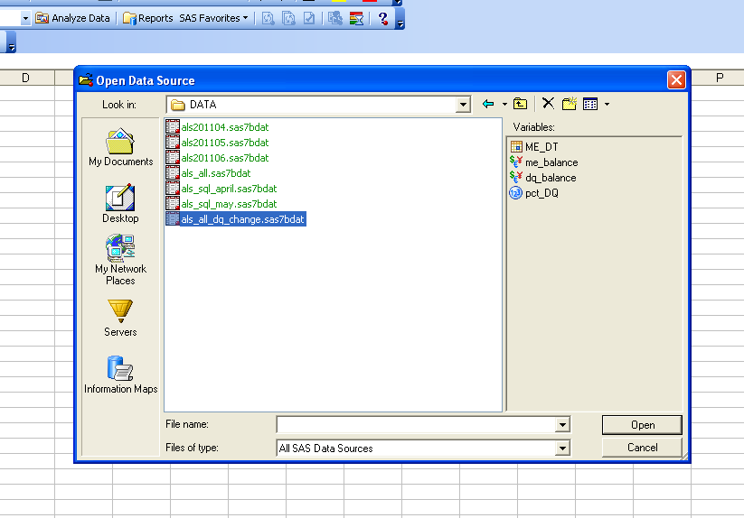
CHAPTER 11: EXCEL Add-In
Navigate to your file in your customer library folder

Slide 9
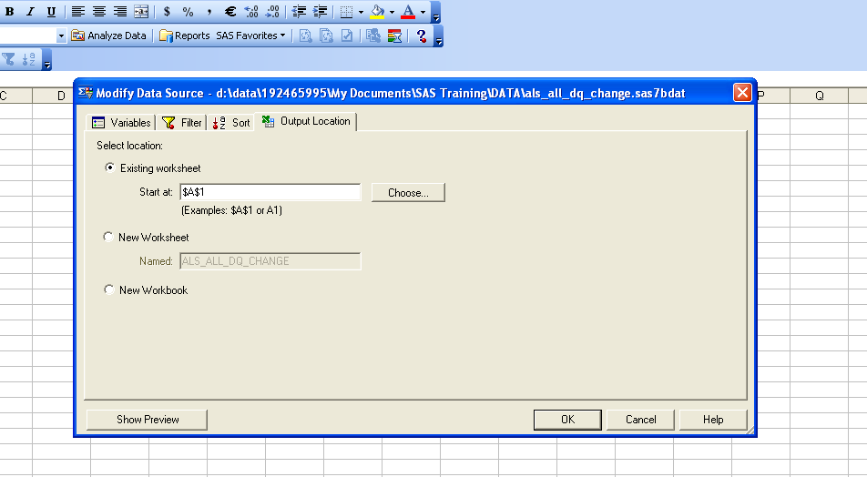
CHAPTER 11: EXCEL Add-In
Select your variables and go to the OUTPUT Location tab and choose existing worksheet
Click okay

Slide 10
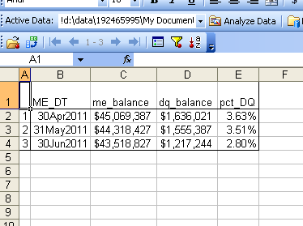
CHAPTER 11: EXCEL Add-In
And there you have it!

Slide 11
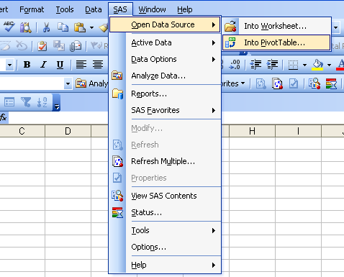
CHAPTER 11: EXCEL Add-In
Now lets create a pivot table from SAS!
SAS ➔ Open Data Source ➔ Into PivotTable

Slide 12
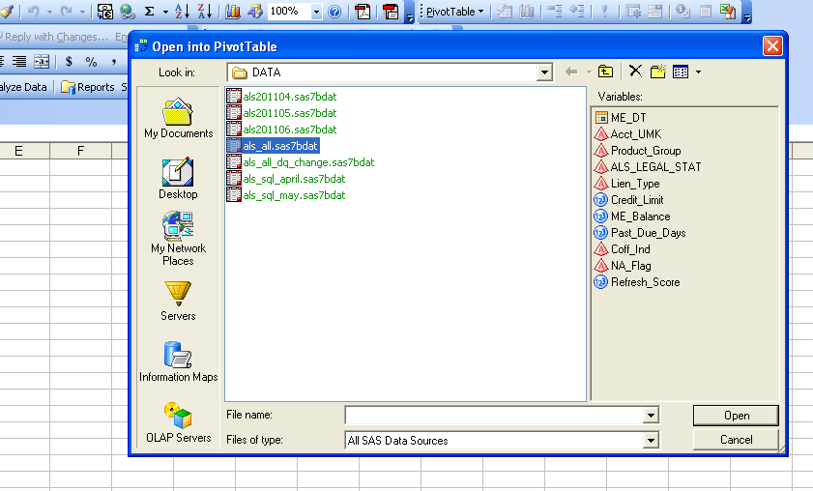
CHAPTER 11: EXCEL Add-In
Choose you ALS_All table in your customer folder.

Slide 13
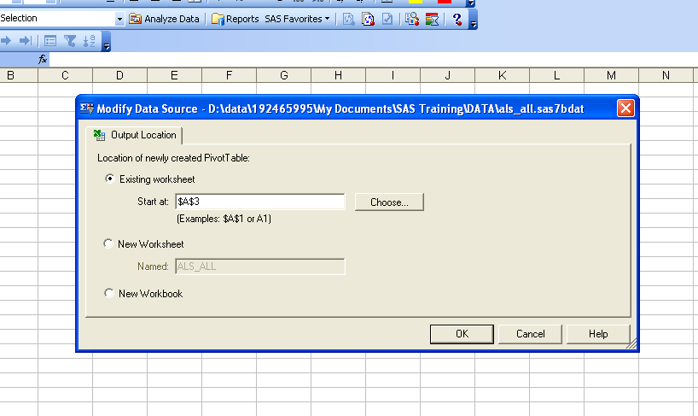
CHAPTER 11: EXCEL Add-In
Choose Existing worksheet
Click OK

Slide 14
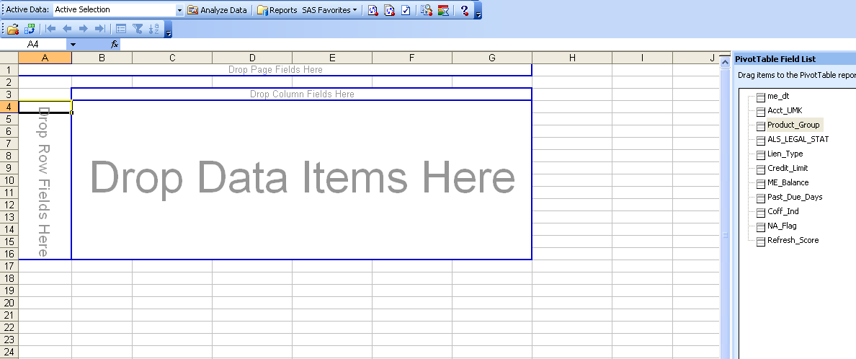
CHAPTER 11: EXCEL Add-In
And there you have it!

Slide 15
SAS ALL STARS!!!!!!!
CONGRATULATIONS!!!!!!!!!!!!!!!

